Slide 1
Stock market variations by means of information theory
Eugenio E. Vogel, Gonzalo Saravia
Universidad de La Frontera, Temuco, Chile
COMPLEX SYSTEMS
FOUNDATIONS AND APPLICATIONS
Rio de Janeiro, Brazil
October 29 – November 1, 2013

Slide 2
70 Constatino Tsallis 70
Happy Birthday
Feliz Cumpleaños

Slide 3
Outline
Why Chilean Stock Market?
Year 2010. Why?
Data compressor wlzip: definitions
Application of wlzip to magnetic transitions
Chilean Stock Market
Application of wlzip to IPSA
Static studies (fixed time window)
Dynamic studies (moving time window)
Conclusions

Slide 4
Why Chilean stock market?
Open economy
Operates under international standards
No special restrictions on foreign currency
It is a small market by volume but representative of larger ones in procedures and protocols.

Slide 5
Why year 2010?
Access to minute variation of data of the main Chilean stock market during 2010.
On February 27, 2010 there was a huge earthquake in central Chile.
Was this phenomenon significant in the Chilean stock market?

Slide 6
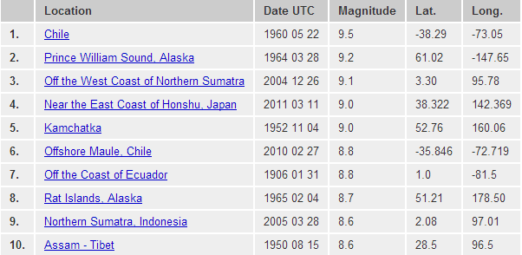
2010.02.27: sixth largest earthquake hit Chile. SSM closed for three days
Source: U.S. Geological Survey

Slide 7
A new tool:
Data compressor
Wlzip
Word length zipper

Slide 8
New tool: data compressor wlzip. Consider file storing initial 15 minute values of BCS indicator IPSA for the day: May 13, 2010
Original file
Compressed file
3891
3891
3892
3893
3891
3891
3890
3888
3888
3887
3886
3886
3885
3887
3887
3891 0,2 4,2
3892 2
3893 3
3890 6
3888 7,2
3887 9 4,2
3886 10,2
3885 12
8 lines
w*
15 lines
w

Slide 9
Basic definitions
Q( α,t) : variable stored sequentially in a file
α : set of independent variables determining Q
t: sequential variable (time or steps).
w_{i}(Q(α,t)) : weight in bytes of the original file
w_{i}*(Q(α)) : weight in bytes of the compressed file
λ_{i}(Q(α,t)) : lines of the original file
λ_{i}*(Q(α)) : lines of the compressed file
Mutability:
Diversity:

Slide 10
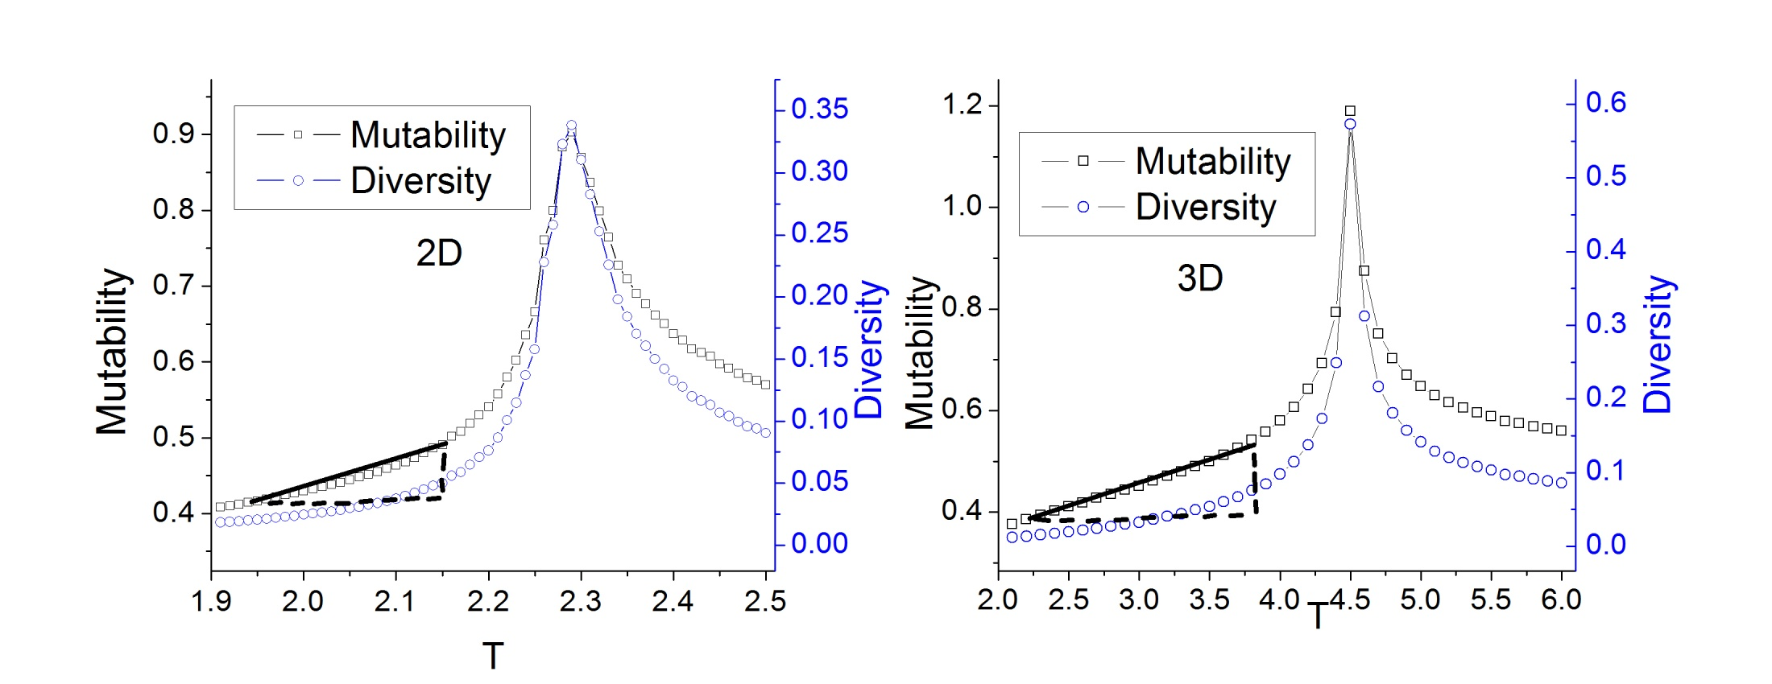
Magnetic phase transitions: 2D and 3D Ising model
Diversity identifies better the transition temperature
Mutability varies more smoothly with temperature;
it cam be used to measure temperature or agitation

Slide 11
Chilean stock markets
Main stock market is Bolsa de Comercio de Santiago (BCS).
BCS has two main indicators: IGPA (general) and IPSA (selective).
We pick IPSA since it is more dynamical
It is based on the price variation of the 40 most traded stocks.
Values of IPSA are reported every minute through the web

Slide 12
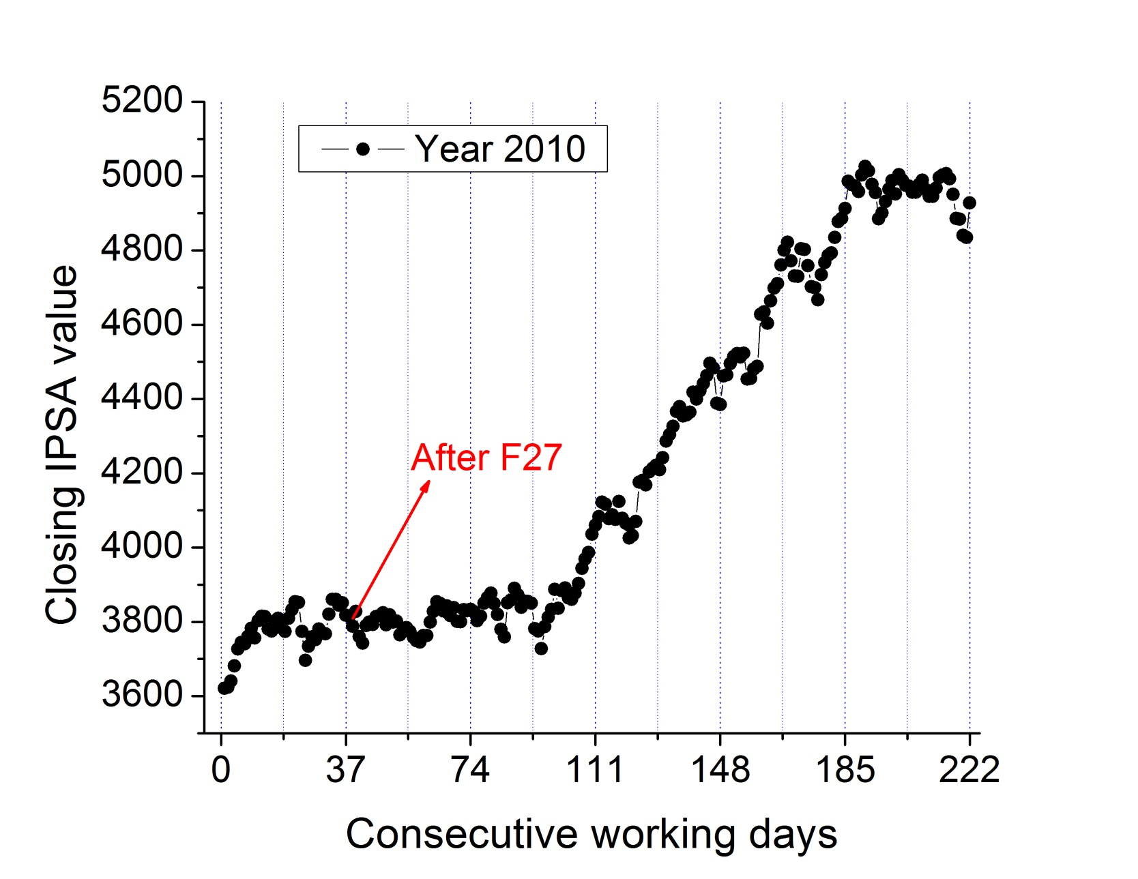
Closing values through 2010

Slide 13
Daily mutability and diversity
Every working day i minutely IPSA values are stored in a sequential file.
w_{i}(Q(α,t))= w_{i}(IPSA(BCS,minutes of operation))
=w_{i} ; this is weight of the original file
λ_{i}(Q(α,t)) =λ_{i}: number of lines in original file
Data compressor wlzip is invoked
w*_{i} is weight of the compressed file
λ*_{i}: number of lines in compressed file
Daily values for μ and δ are readily obtained.

Slide 14
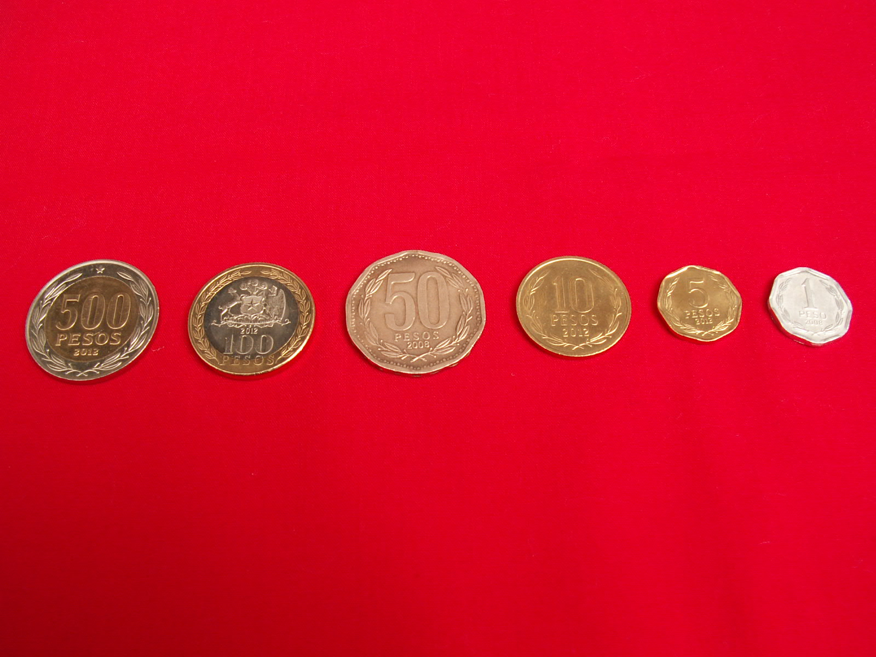
Tuning the compressor
Typical share value: 2345
Value used for compression: 2345
Code: 1,3

Slide 15
Applications I
Static Studies

Slide 16
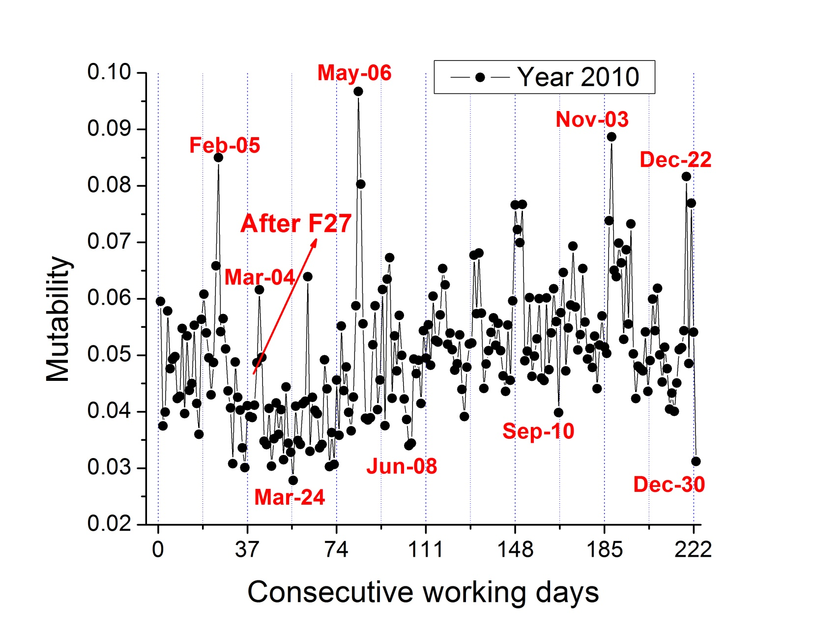
Daily mutability

Slide 17
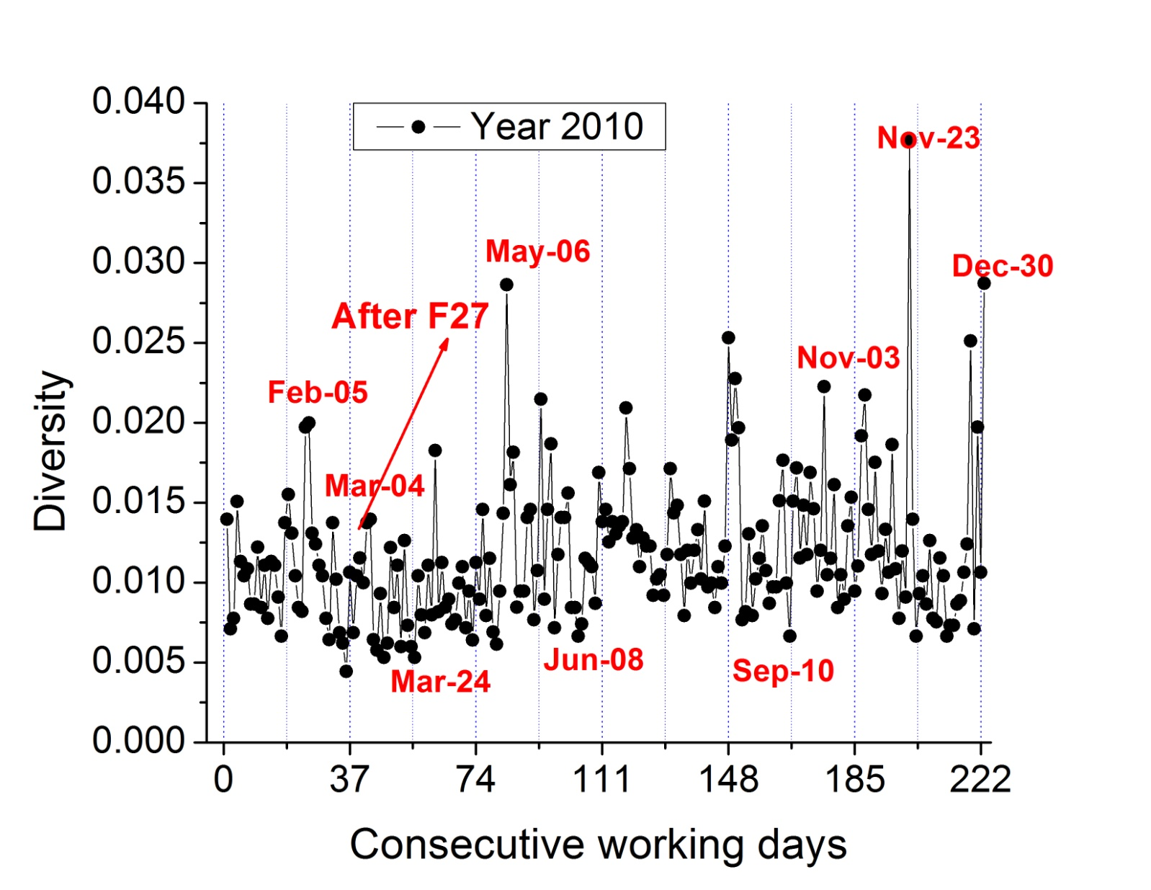
Daily diversity

Slide 18
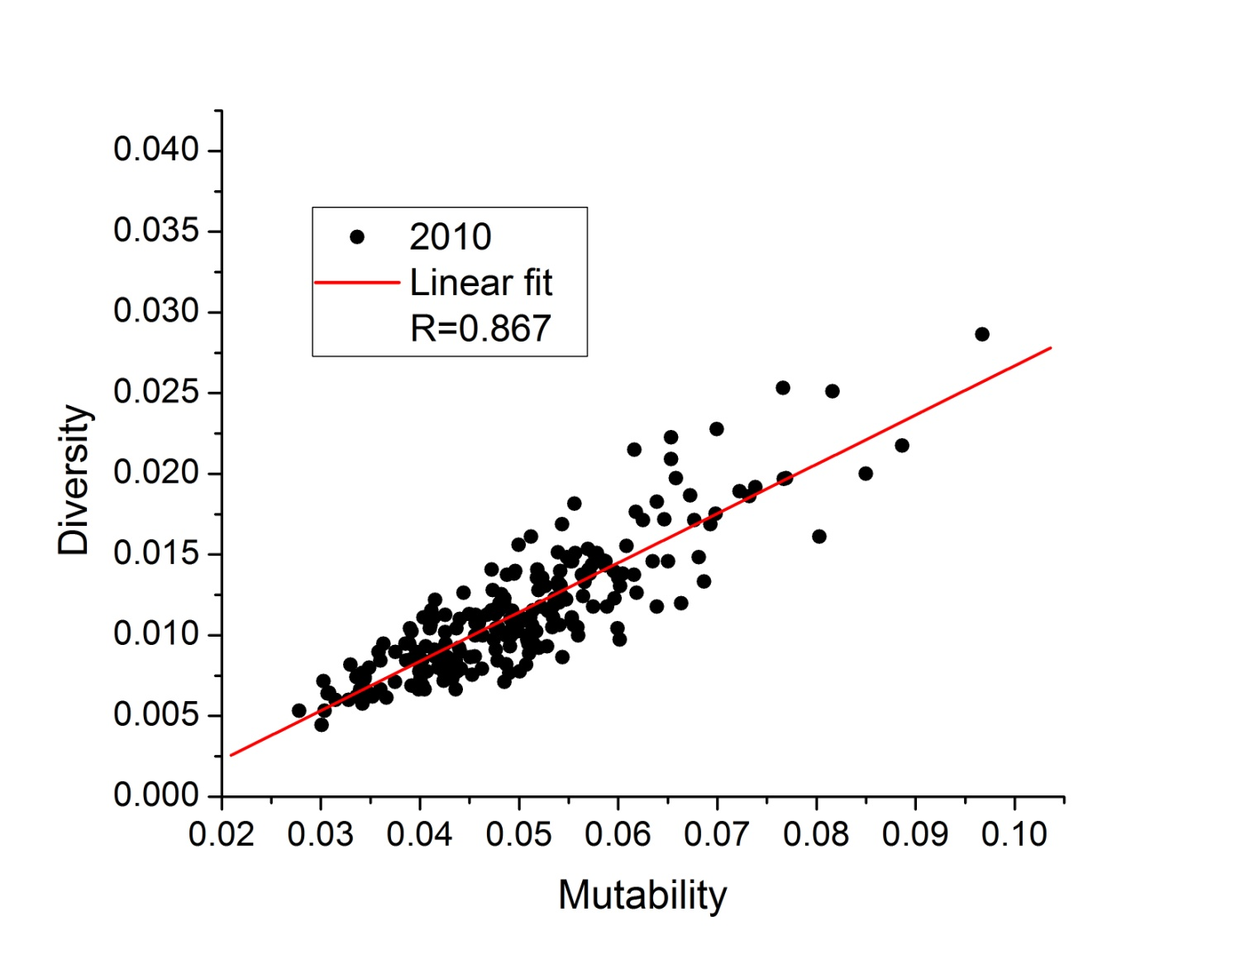
How correlated are μ and δ ?

Slide 19
Profitability p(t,τ) of any asset over a recent time interval τ
v(t) : value of asset at time t

Slide 20
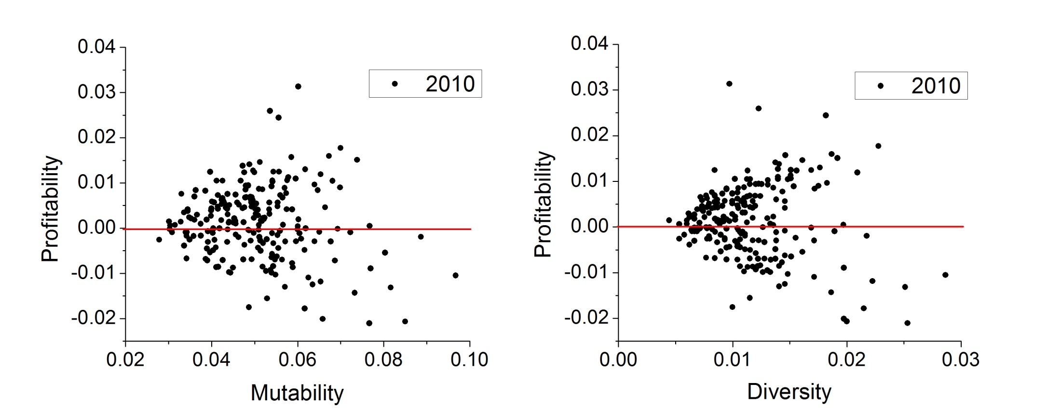
Correlations between P and μ or δ

Slide 21
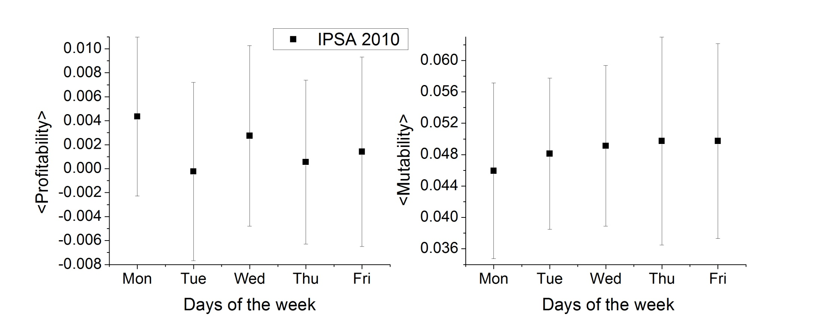
Day of the week effect

Slide 22
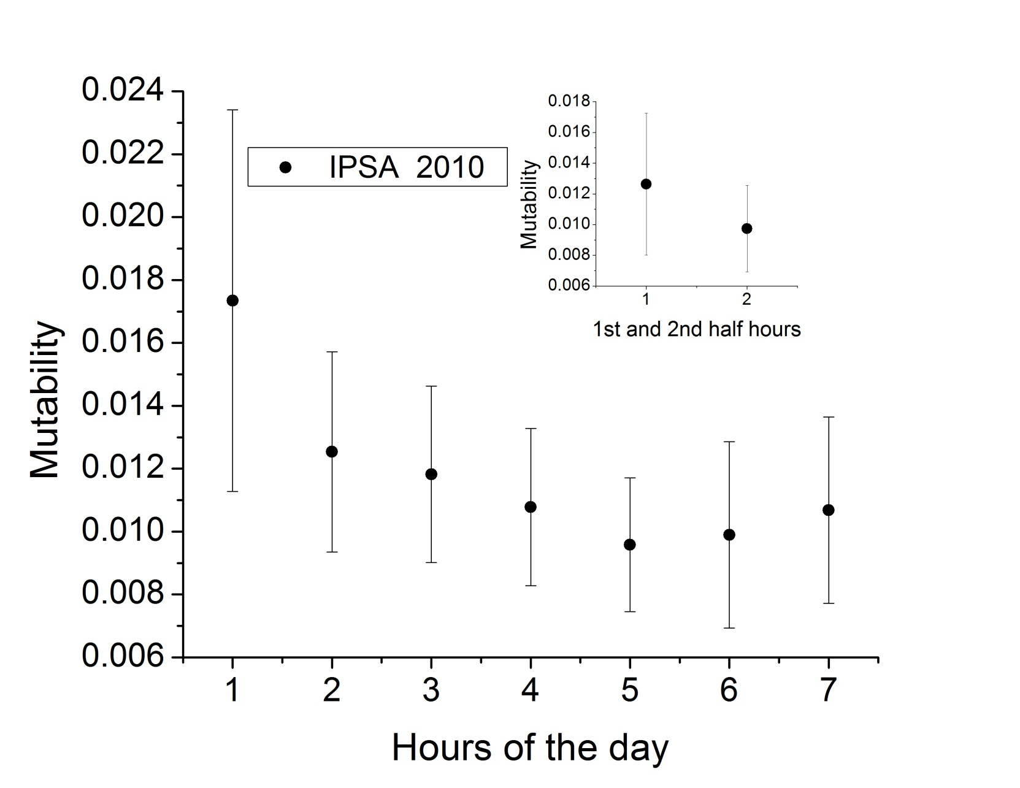
Hour of the day effect I

Slide 23
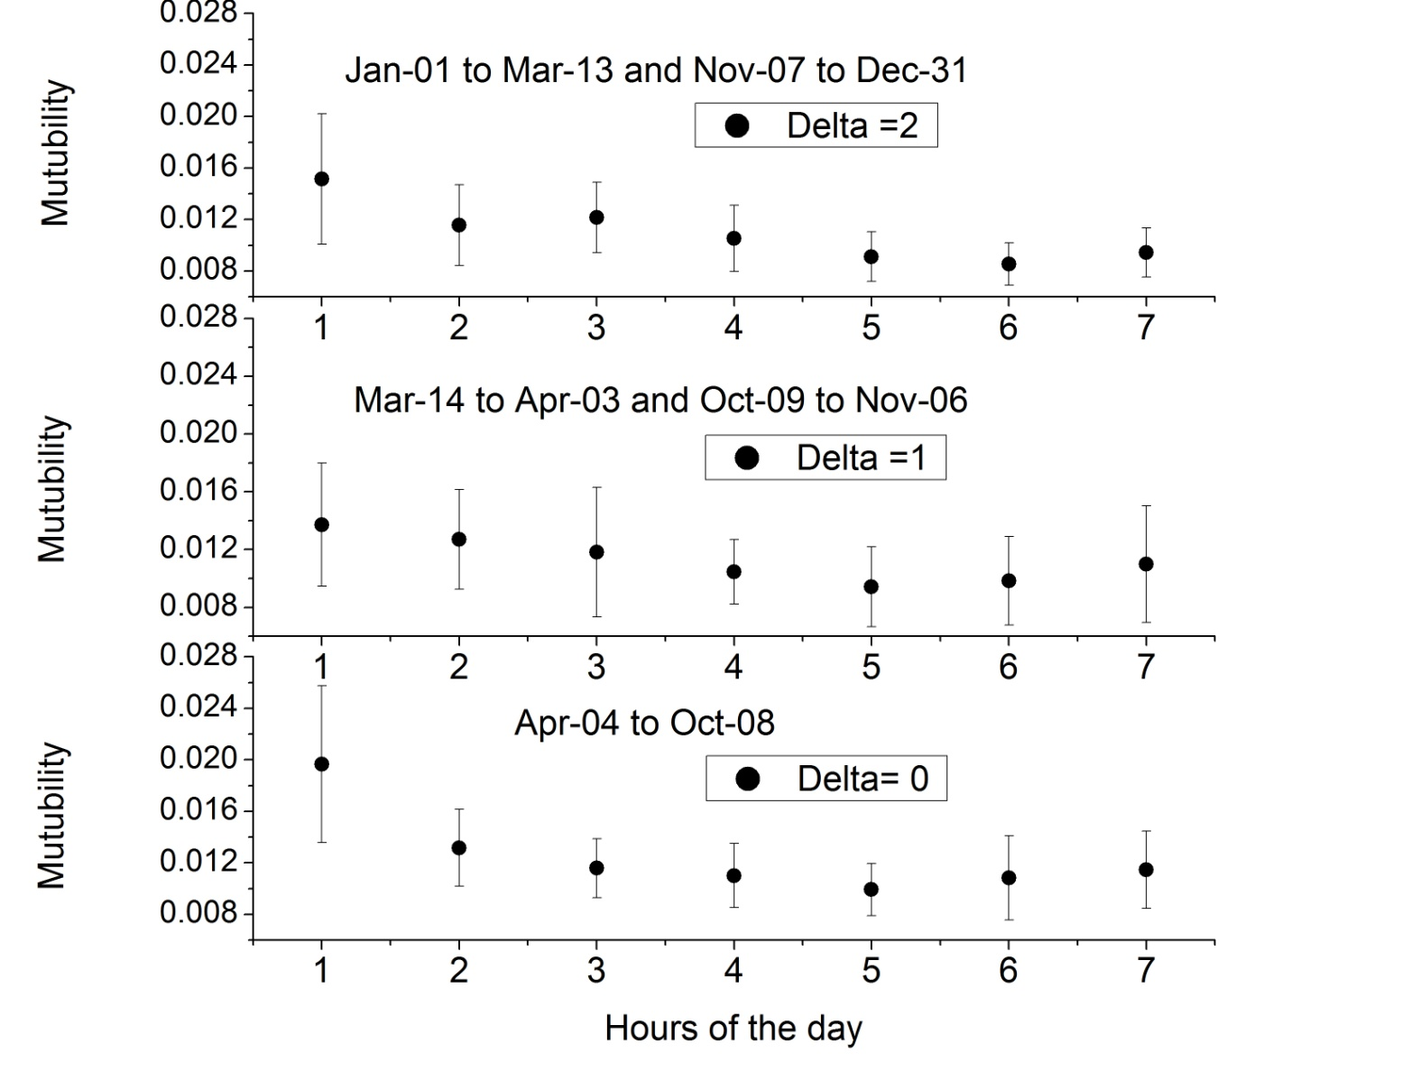
Hour of the day effect II

Slide 24
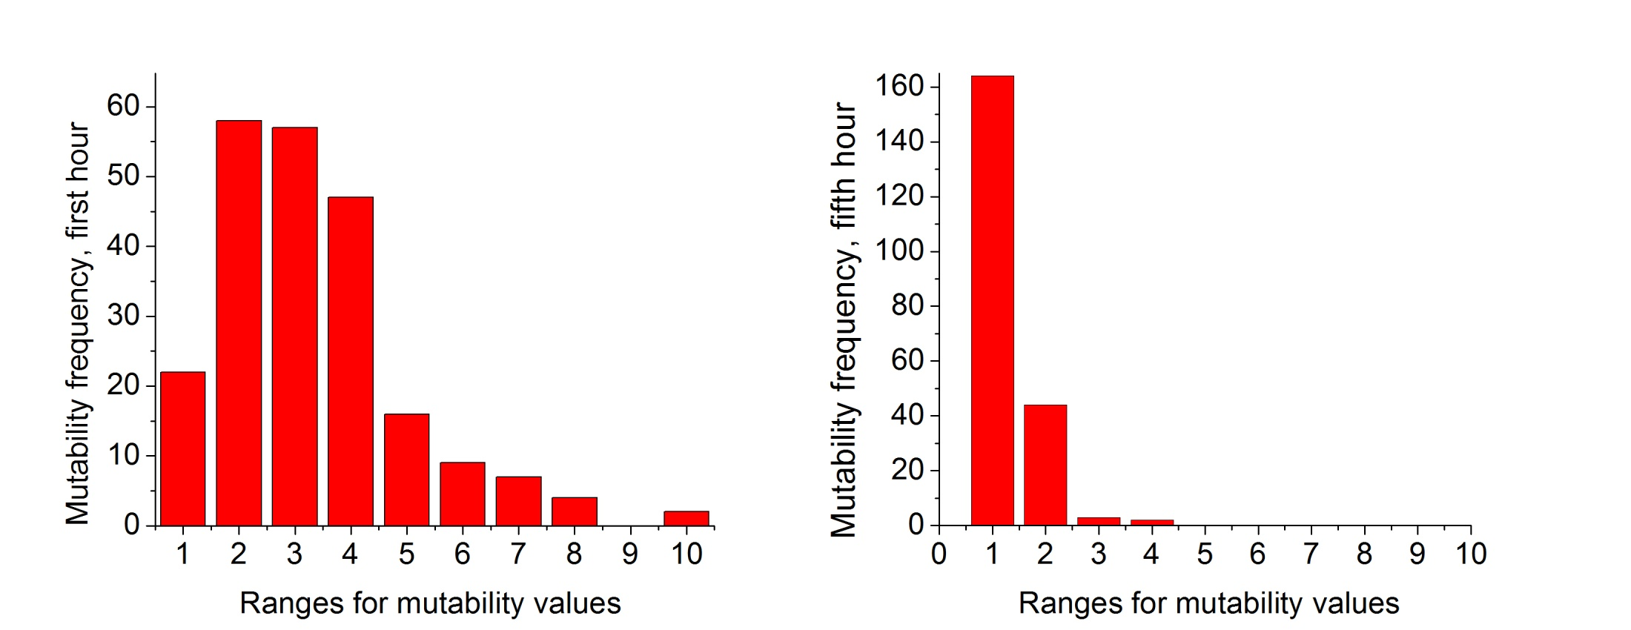
Mutability frequencies: first and fifth hours

Slide 25
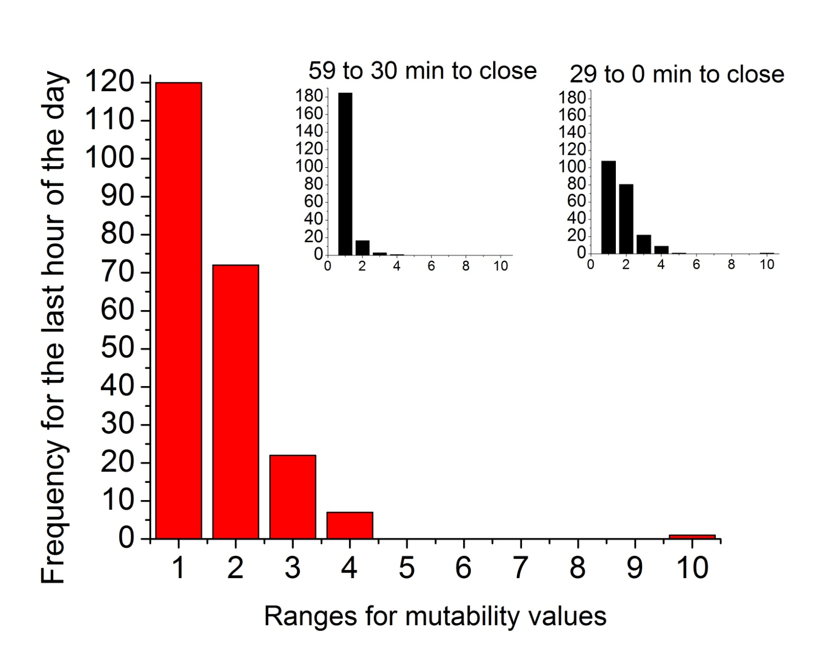
Mutability frequencies: last hour

Slide 26
Applications II
Dynamic Studies

Slide 27
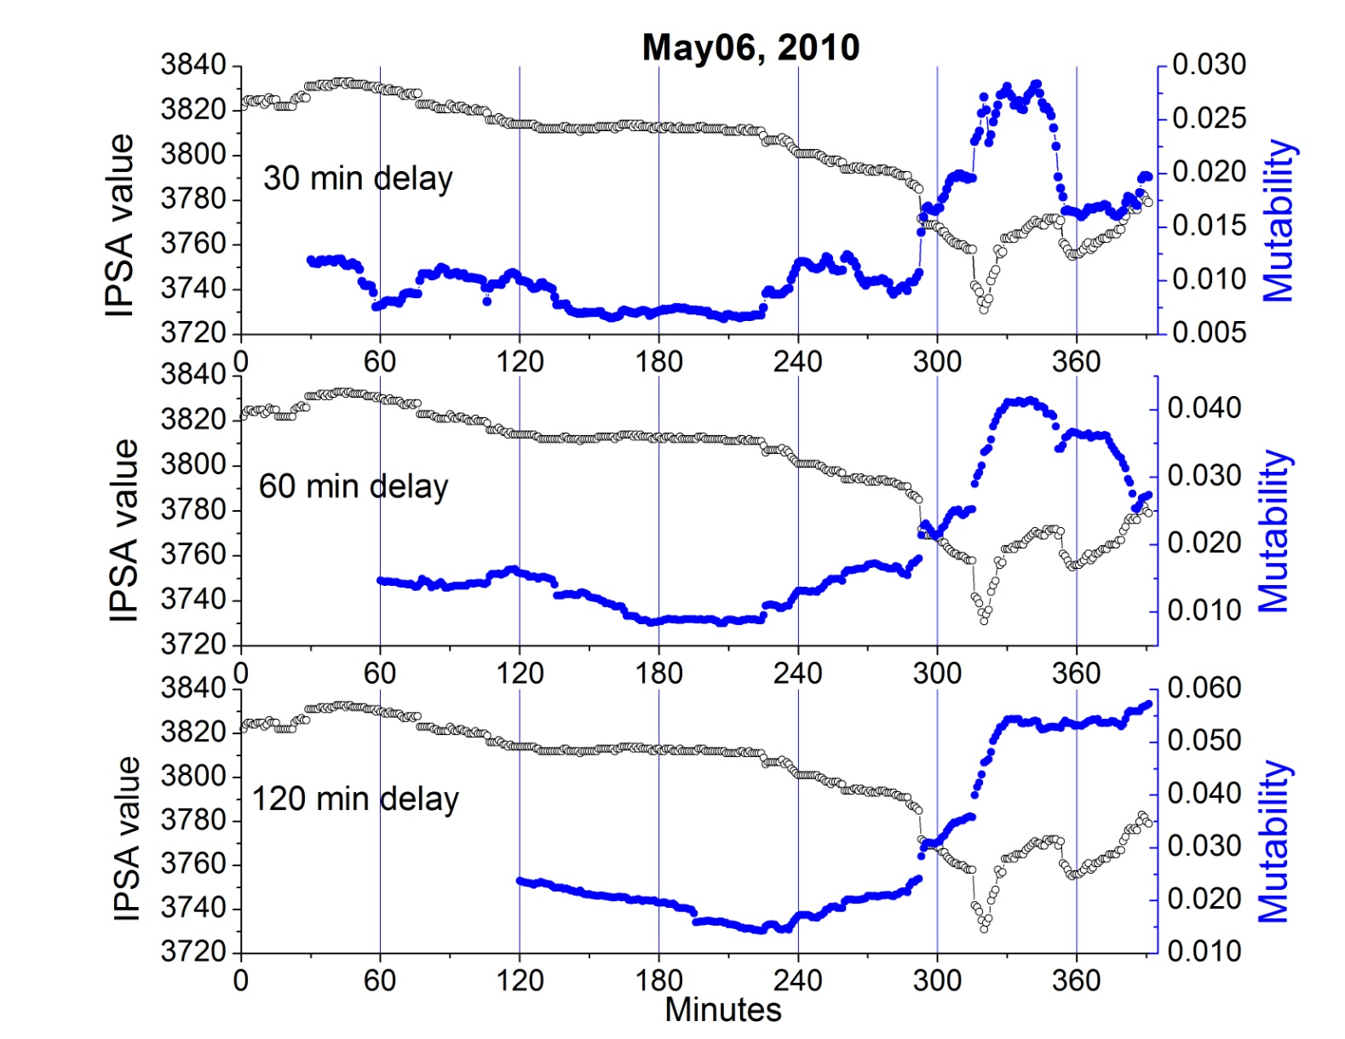
Different moving time windows

Slide 28
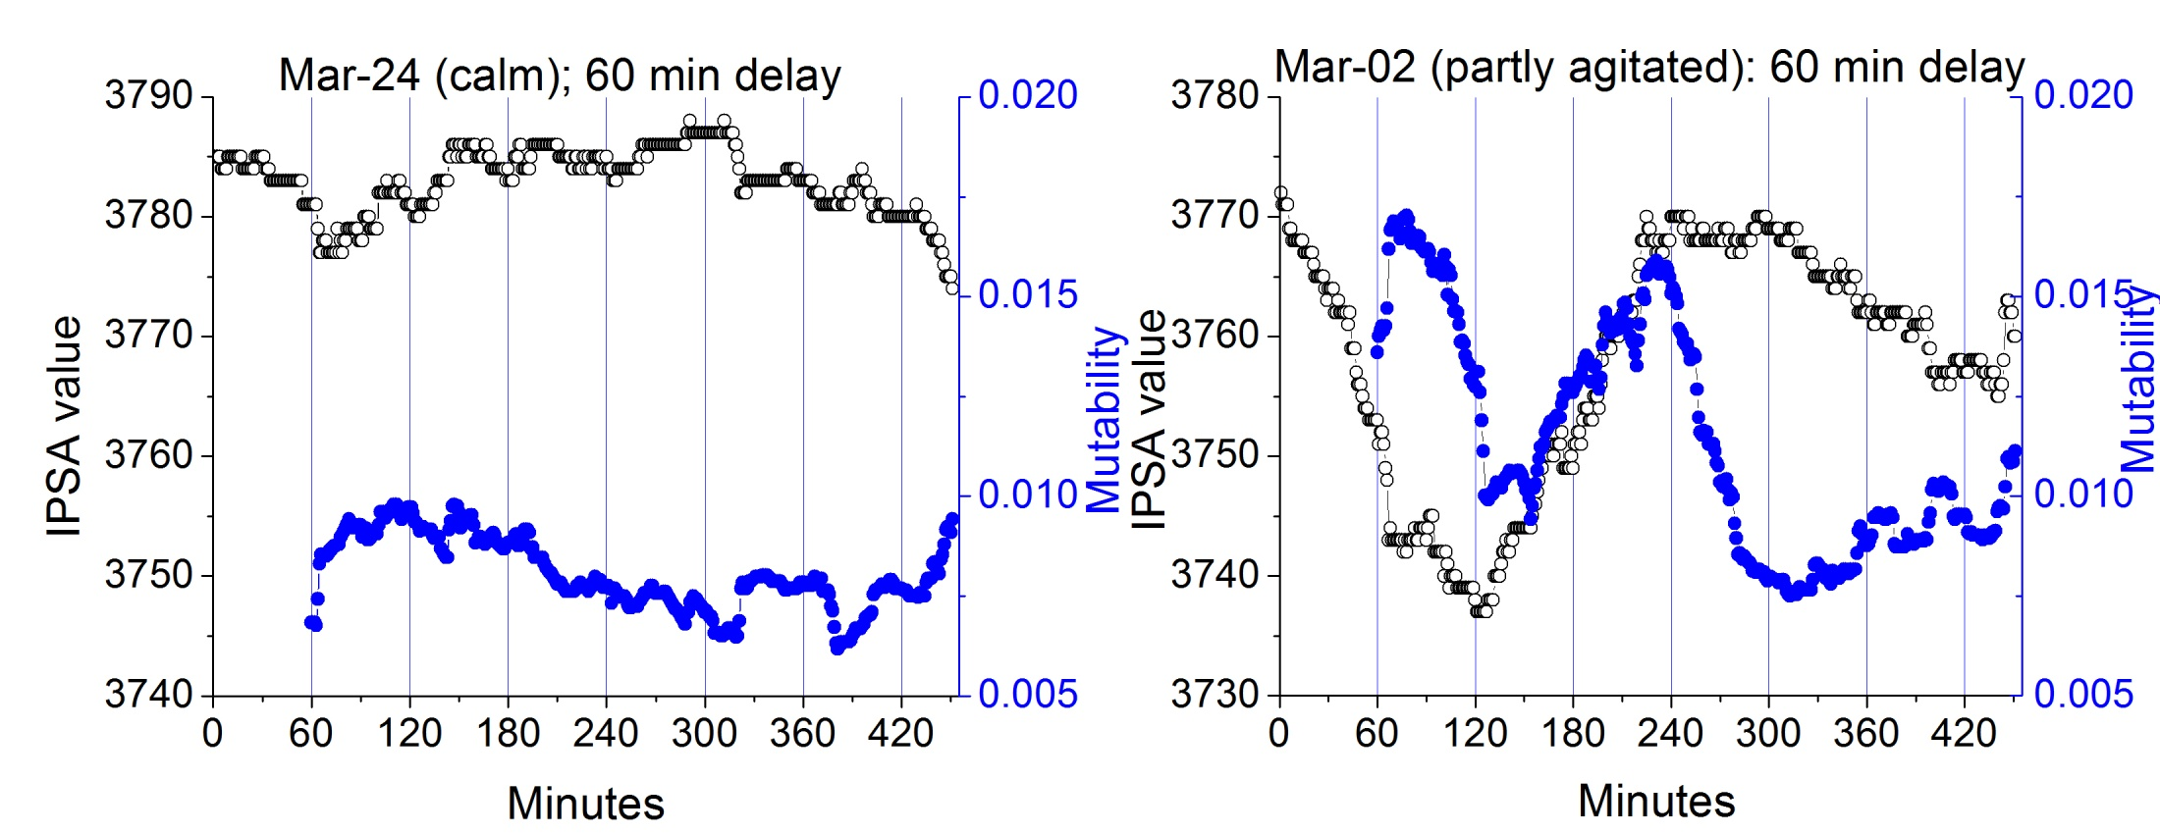
Mutability for 2 different days

Slide 29
Definition of new parameter: Sensitivity
We need a parameter that has the sign of profitability and follows the variations of mutability:
p(t,τ’): profitability for interval τ’ ending at t
μ(t,τ): mutability for interval τ’ ending at t
κ(τ,τ’): arbitrary constant to calibrate sensitivity

Slide 30
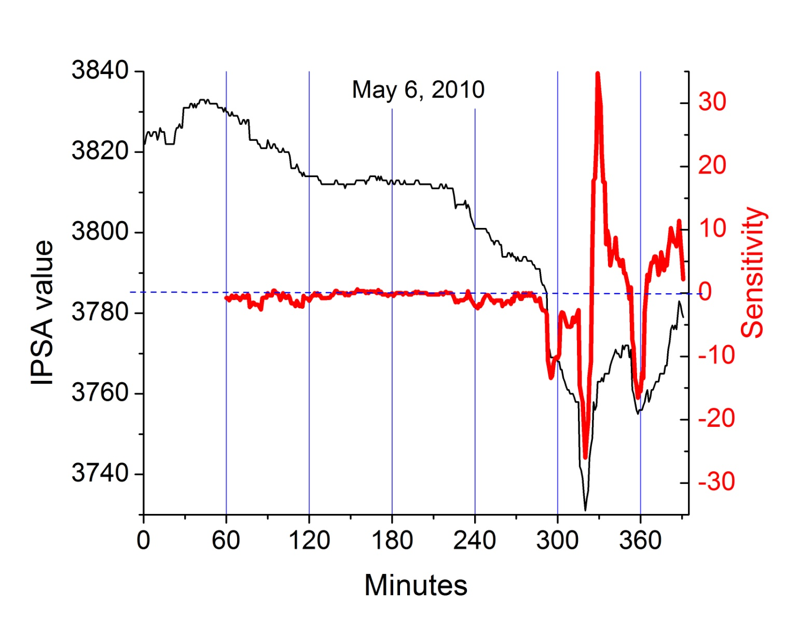
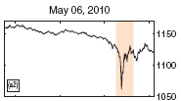
Sensitivity for May 6 !!!
Filimonov & Sornette, Phys. Rev. E 85 (2012) 056108

Slide 31
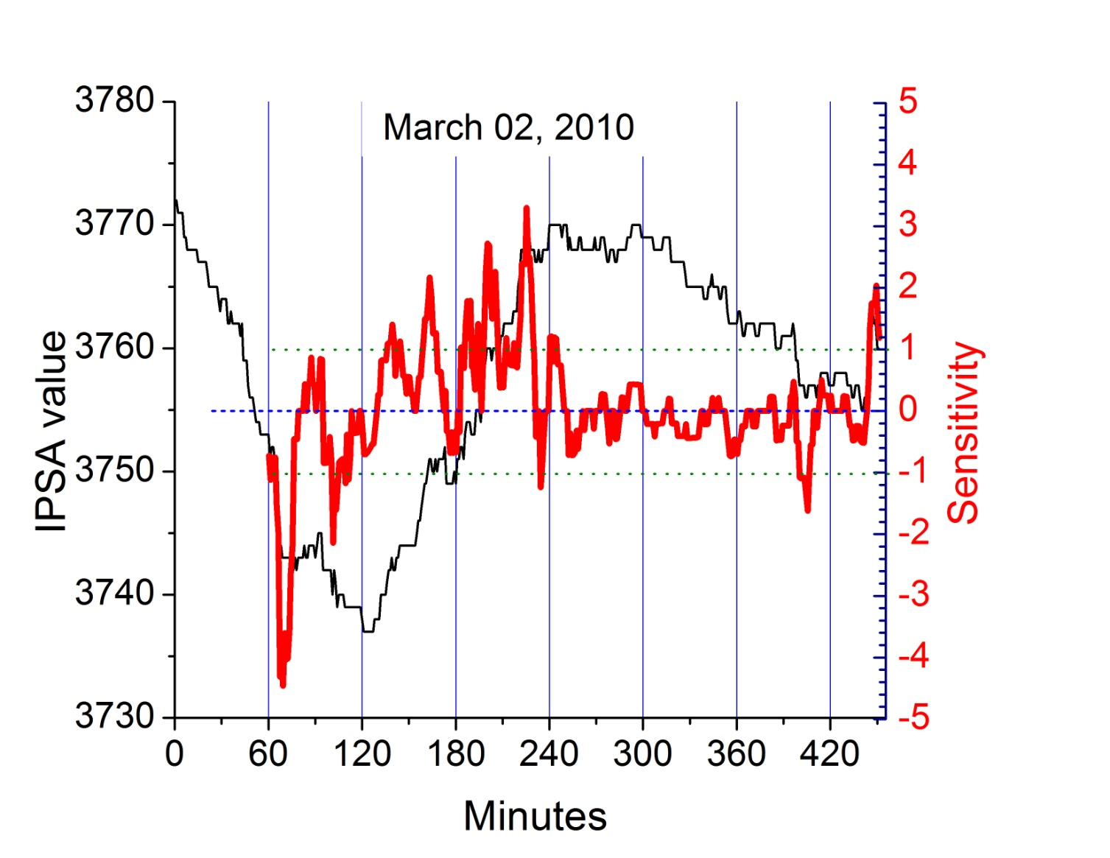
Sensitivity immediately after F27

Slide 32
Conclusions
Compressor wlzip renders two pieces of information: μ and δ
Application of wlzip to 2D and 3D Ising model yields the due critical temperatures.
Application of wlzip to 2010 IPSA values of BCS produces valuable information.
There is no correlation between profitability of IPSA with neither μ or δ.

Slide 33
Conclusions II
The day of the week effect is not clear for BCS
The hour of the day effect is present early in the day due to exogenous reasons.
The last hour also presents agitation.
The combination of profitability and mutability allows to define an indicator (sensitivity) which could be used in predictions
2010 was a good year for BCS in spite of the huge earthquake of F27

Slide 34
Many Thanks!!

