Slide 1



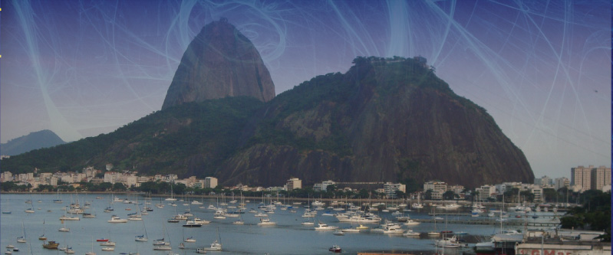



A scale invariant probabilistic model
based on Leibniz-like pyramids
Antonio Rodríguez^{1,2}
¹Dpto. Matemática Aplicada y Estadística.
Universidad Politécnica de Madrid
²Grupo Interdisciplinar de Sistemas Complejos

Slide 2
Outline
One-dimensional model.
  Scale invariant triangles.
  q-entropy.
Two-dimensional model.
  Scale invariant tetrahedrons.
  Conditional and marginal distributions.
Generalization to arbitrary dimension.
Conclusions.

Slide 3
q-gaussianity
scale invariance
extensivity

Slide 4
scale invariance
marginal
probability distribution
variables
joint probability distribution
N-1 variables
joint
N
N-1
A. Rodríguez, C. Tsallis and V. Schammle, J. Stat. Mech: theor. exp. P09006 (2008)

Slide 5
Scale invariance
marginal
probability distribution
variables
joint probability distribution
N-1 variables
joint
N
N-1
A. Rodríguez, C. Tsallis and V. Schammle, J. Stat. Mech: theor. exp. P09006 (2008)

Slide 6

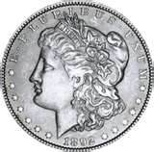
One-dimensional model.
N distinguisable 1d-binary independent variables
N=1
x₁
0
1
p
1-p
1
A. Rodríguez, C. Tsallis and V. Schammle, J. Stat. Mech: theor. exp. P09006 (2008)

Slide 7
One-dimensional model.
N distinguisable 1d-binary independent variables
N=2
x₁
x₂
1
0
1
p²
p (1-p)
0
p (1-p)
(1-p)²
A. Rodríguez, C. Tsallis and V. Schammle, J. Stat. Mech: theor. exp. P09006 (2008)

Slide 8
One-dimensional model.
N distinguisable 1d-binary independent variables
N=2
x₁
x₂
1
0
1
p²
p (1-p)
p
0
p (1-p)
(1-p)²
1-p
p
1-p
A. Rodríguez, C. Tsallis and V. Schammle, J. Stat. Mech: theor. exp. P09006 (2008)

Slide 9
One-dimensional model.
N=3
p²(1-p)
p(1-p)²
x₃=0
p(1-p)²
(1-p)³
x₃=1
p³
p²(1-p)
p²(1-p)
p(1-p)²
p²
p(1-p)
p(1-p)
(1-p)²
A. Rodríguez, C. Tsallis and V. Schammle, J. Stat. Mech: theor. exp. P09006 (2008)

Slide 10
One-dimensional model.
N=3
p²(1-p)
p(1-p)²
p(1-p)²
(1-p)³
N=0
N=1
N=2
1
p 1-p
p³
p²(1-p)
p²(1-p)
p(1-p)²
p²
p(1-p)
p(1-p)
(1-p)²
A. Rodríguez, C. Tsallis and V. Schammle, J. Stat. Mech: theor. exp. P09006 (2008)

Slide 11
One-dimensional model.
Leibniz rule
N=0
N=1
N=2
1
p 1-p
+
p²
p(1-p)
+
(1-p)²
N=3
p³
p²(1-p)
+
p(1-p)²
(1-p)³
A. Rodríguez, C. Tsallis and V. Schammle, J. Stat. Mech: theor. exp. P09006 (2008)

Slide 12
One-dimensional model.
CLT
Binomial distribution
Gaussian
1
p 1-p
N=0
N=1
N=2
1
1
1
p²
(1-p)²
1
2
1
p(1-p)
1
p²(1-p)
p(1-p)²
p³
3
1
N=3
3
(1-p)³
Pascal triangle
A. Rodríguez, C. Tsallis and V. Schammle, J. Stat. Mech: theor. exp. P09006 (2008)

Slide 13
Scale invariant triangles
N=0
N=1
N=2
1
p 1-p
p²
p(1-p)
(1-p)²
N=3
p³
p²(1-p)
p(1-p)²
(1-p)³
A. Rodríguez, C. Tsallis and V. Schammle, J. Stat. Mech: theor. exp. P09006 (2008)

Slide 14
Scale invariant triangles
Leibniz
triangle
N=0
N=1
N=2
N=3
A. Rodríguez, C. Tsallis and V. Schammle, J. Stat. Mech: theor. exp. P09006 (2008)

Slide 15
Scale invariant triangles
Leibniz
triangle
N=0
N=1
N=2
N=3
A. Rodríguez, C. Tsallis and V. Schammle, J. Stat. Mech: theor. exp. P09006 (2008)

Slide 16
Scale invariant triangles
Leibniz
triangle
N=0
N=1
N=2
N=3
A. Rodríguez, C. Tsallis and V. Schammle, J. Stat. Mech: theor. exp. P09006 (2008)

Slide 17
Scale invariant triangles
N=0
N=1
N=2
N=3
A. Rodríguez, C. Tsallis and V. Schammle, J. Stat. Mech: theor. exp. P09006 (2008)

Slide 18
Scale invariant triangles
A. Rodríguez, C. Tsallis and V. Schammle, J. Stat. Mech: theor. exp. P09006 (2008)

Slide 19
Scale invariant triangles
A. Rodríguez, C. Tsallis and V. Schammle, J. Stat. Mech: theor. exp. P09006 (2008)

Slide 20
Scale invariant triangles
A. Rodríguez, C. Tsallis and V. Schammle, J. Stat. Mech: theor. exp. P09006 (2008)

Slide 21
Scale invariant triangles
A. Rodríguez, C. Tsallis and V. Schammle, J. Stat. Mech: theor. exp. P09006 (2008)

Slide 22
Scale invariant triangles
R. Hanel, S. Thurner and C. Tsallis. Eur. Phys. J. B 72, 263 (2009)

Slide 23
Outline
One-dimensional model.
  Scale invariant triangles.
  q-entropy.
Two-dimensional model.
  Scale invariant tetrahedrons.
  Conditional and marginal distributions.
Generalization to arbitrary dimension.
Conclusions

Slide 24
q-gaussianity
scale invariance
?
?
extensivity
for

Slide 25
q-entropy

Slide 26
q-gaussianity
scale invariance
?
?
extensivity
for

Slide 27
q-gaussianity
scale invariance
?
extensivity

Slide 28
Outline
One-dimensional model.
  Scale invariant triangles.
  q-entropy.
Two-dimensional model.
  Scale invariant tetrahedrons.
  Conditional and marginal distributions.
Generalization to arbitrary dimension.
Conclusions

Slide 29

Two dimensional model
N distinguisable independent variables
2d-ternary
N=1
(x₁ , y₁)
(1 , 0)
(0 , 1)
(0 , 0)
p
q
1-p-q
1
A. Rodríguez and C. Tsallis, J. Math. Phys 53, 023302 (2012)

Slide 30
Two dimensional model
N distinguisable 2d-ternary independent variables
N=2
(x₁ , y₁)
(1 , 0)
(0 , 1)
(0 , 0)
(x₂ , y₂)
(1 , 0)
p²
pq
p(1-p-q)
p
(0 , 1)
pq
q²
q(1-p-q)
q
(0 , 0)
p(1-p-q)
q(1-p-q)
(1-p-q) ²
1-p-q
p
q
1-p-q
A. Rodríguez and C. Tsallis, J. Math. Phys 53, 023302 (2012)

Slide 31
N=0
1
N=2
N=1
p²
p³
pq
q²
p²q
p²(1-p-q)
N=3
p(1-p-q)
q(1-p-q)
(1-p-q) ²
pq²
pq (1-p-q)
p(1-p-q) ²
q³
q²(1-p-q)
q (1-p-q) ²
p
q
1-p-q
(1-p-q) ³

Slide 32
N=0
1
Generalized Leibniz rule
p
N=1
+
+
q
+
1-p-q
p²
N=2
pq
p(1-p-q)
+
+
q²
q(1-p-q)
+
(1-p-q) ²
p³
p²q
p²(1-p-q)
N=3
+
+
pq²
+
pq (1-p-q)
p(1-p-q) ²
+
+
+
q³
q²(1-p-q)
q (1-p-q) ²
(1-p-q) ³

Slide 33
CLT
Trinomial distribution
2d-Gaussian
1
N=0
1
Pascal pyramid
1
p
N=1
1
q
1-p-q
1
p²
1
pq
N=2
2
2
p(1-p-q)
1
2
1
q²
q(1-p-q)
(1-p-q) ²
1
p³
p²q
3
3
p²(1-p-q)
N=3
pq²
6
3
3
pq (1-p-q)
p(1-p-q) ²
1
3
3
q (1-p-q) ²
q³
q²(1-p-q)
(1-p-q) ³
1

Slide 34
N=0
1
p
N=1
q
1-p-q
p²
N=2
pq
p(1-p-q)
q²
q(1-p-q)
(1-p-q) ²
p³
p²q
p²(1-p-q)
N=3
pq²
pq (1-p-q)
p(1-p-q) ²
q³
q²(1-p-q)
q (1-p-q) ²
(1-p-q) ³

Slide 35
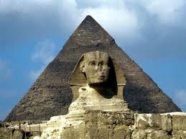
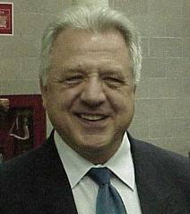
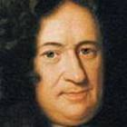
N=0
N=1
Leibniz-like
pyramid
N=2
N=3

Slide 36
N=0
N=1
Leibniz-like
pyramid
N=2
N=3

Slide 37
N=0
N=1
Leibniz
pyramid
N=2
N=3

Slide 38
N=0
N=1
N=2
N=3

Slide 39
Scale invariant pyramids

Slide 40
Scale invariant pyramids
?
2D q-Gaussian

Slide 41
Outline
One-dimensional model.
  Scale invariant triangles.
  q-entropy.
Two-dimensional model.
  Scale invariant tetrahedrons.
  Conditional and marginal distributions.
Generalization to arbitrary dimension.
Conclusions

Slide 42
Conditional distributions

Slide 43
Conditional distributions

Slide 44
Marginal distributions
N=3

Slide 45
Marginal distributions
  The three directions yield identical nonsymmetric scale-invariant distributions.

Slide 46
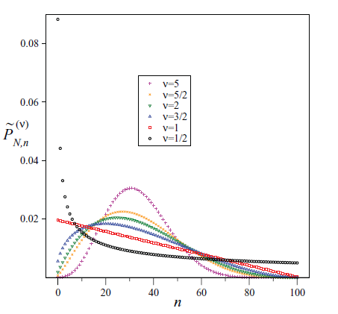
Marginal distributions
  The three directions yield identical nonsymmetric scale-invariant distributions.

Slide 47
Marginal distributions

Slide 48
Marginal distributions
  The direction yields a symmetric non scale-invariant distribution

Slide 49
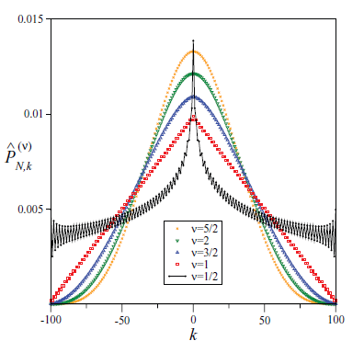
Marginal distributions
  The direction yields a symmetric
  non scale-invariant distribution

Slide 50
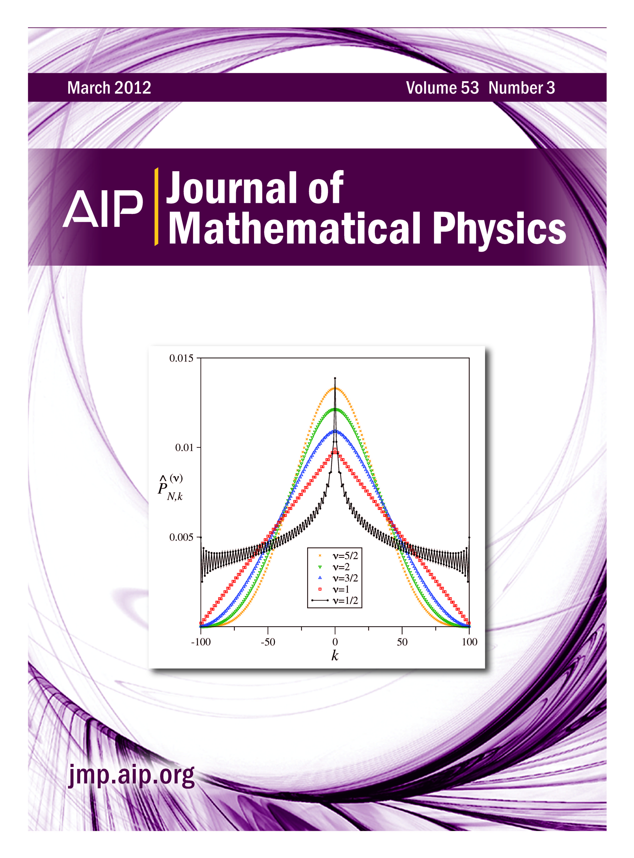
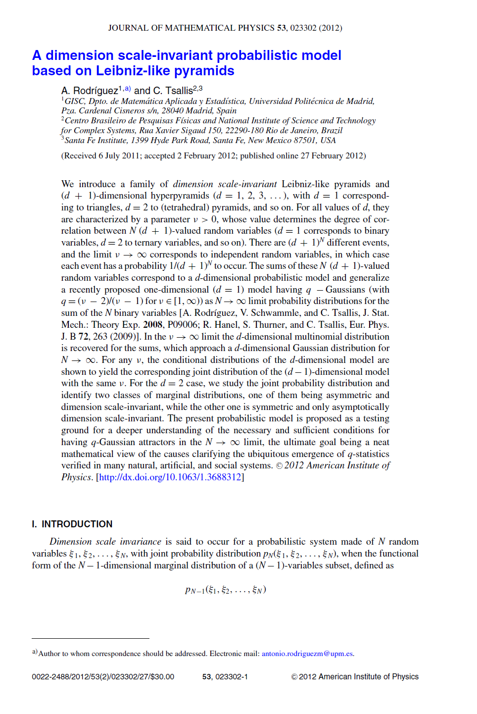

Slide 51
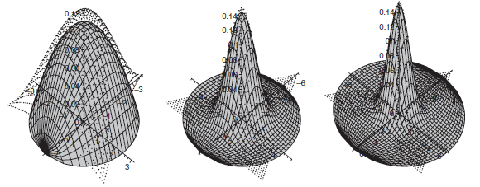
Joint distribution

Slide 52
q-gaussianity
scale invariance
?
extensivity

Slide 53
q-entropy

Slide 54
Outline
One-dimensional model.
  Scale invariant triangles.
  q-entropy.
Two-dimensional model.
  Scale invariant tetrahedrons.
  Conditional and marginal distributions.
Generalization to arbitrary dimension.
Conclusions

Slide 55
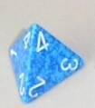
Scale invariant hyperpyramids
N distinguisable independent variables
3d-cuaternary
N=1
(x₁ , y₁, y₁)
(1 , 0 , 0)
(0 , 1 , 0)
(0 , 0 , 1)
(0 , 0 , 0)
p₁
p₂
p₃
1-p₁-p₂-p₃
1
CLT
3D-Gaussian

Slide 56
Scale invariant hyperpyramids
N distinguisable independent variables
3d-cuaternary

Slide 57
Leibniz-like
hyperpyramid
N=0
N=1
N=2
N=3

Slide 58

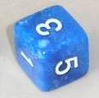
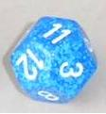
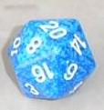
(d + 1)-sided dice
d-dimensional variable
d-dimensional (d+1)-ary variable taking values
Leibniz hyperpyramid

Slide 59
Outline
One-dimensional model.
  Scale invariant triangles.
  q-entropy.
Two-dimensional model.
  Scale invariant tetrahedrons.
  Conditional and marginal distributions.
Generalization to arbitrary dimension.
Conclusions

Slide 60
Conclusions and future work
We have generalized to an arbitrary dimension a one-dimensional discrete probabilistic model which, for one dimension, yields q-gaussians in the thermodynamic limit.
Our two-dimensional model, though containing one-dimensional conditional distributions yielding q-gaussians doesn’t seem to yield bidimensional q-gaussians as limiting probability distributions for .
The case of binary variables is special !!!
The formulation of a probabilistic model yielding multidimensional q-gaussians in the thermmodynamic limit is still an open question.
The relationship between scale invariance, q-gaussianity and extensivity is still an open question.

Slide 61


Slide 62

Thanks!

